Slide 1
MATH 2310
Lecture 1
3/25/2024

Slide 2
Agenda
Introductions
Course Overview and Applications
Syllabus
Introductory Material

Slide 3
About Me

Slide 4

Environmental engineer by training
Undergrad in Civil Engineering at UCLA
Studied low CO₂ emission cement composites
MS/PhD in Environmental Fluid Mechanics at Stanford
Studied how waves and turbulence move mud around in San Francisco Bay

Slide 5
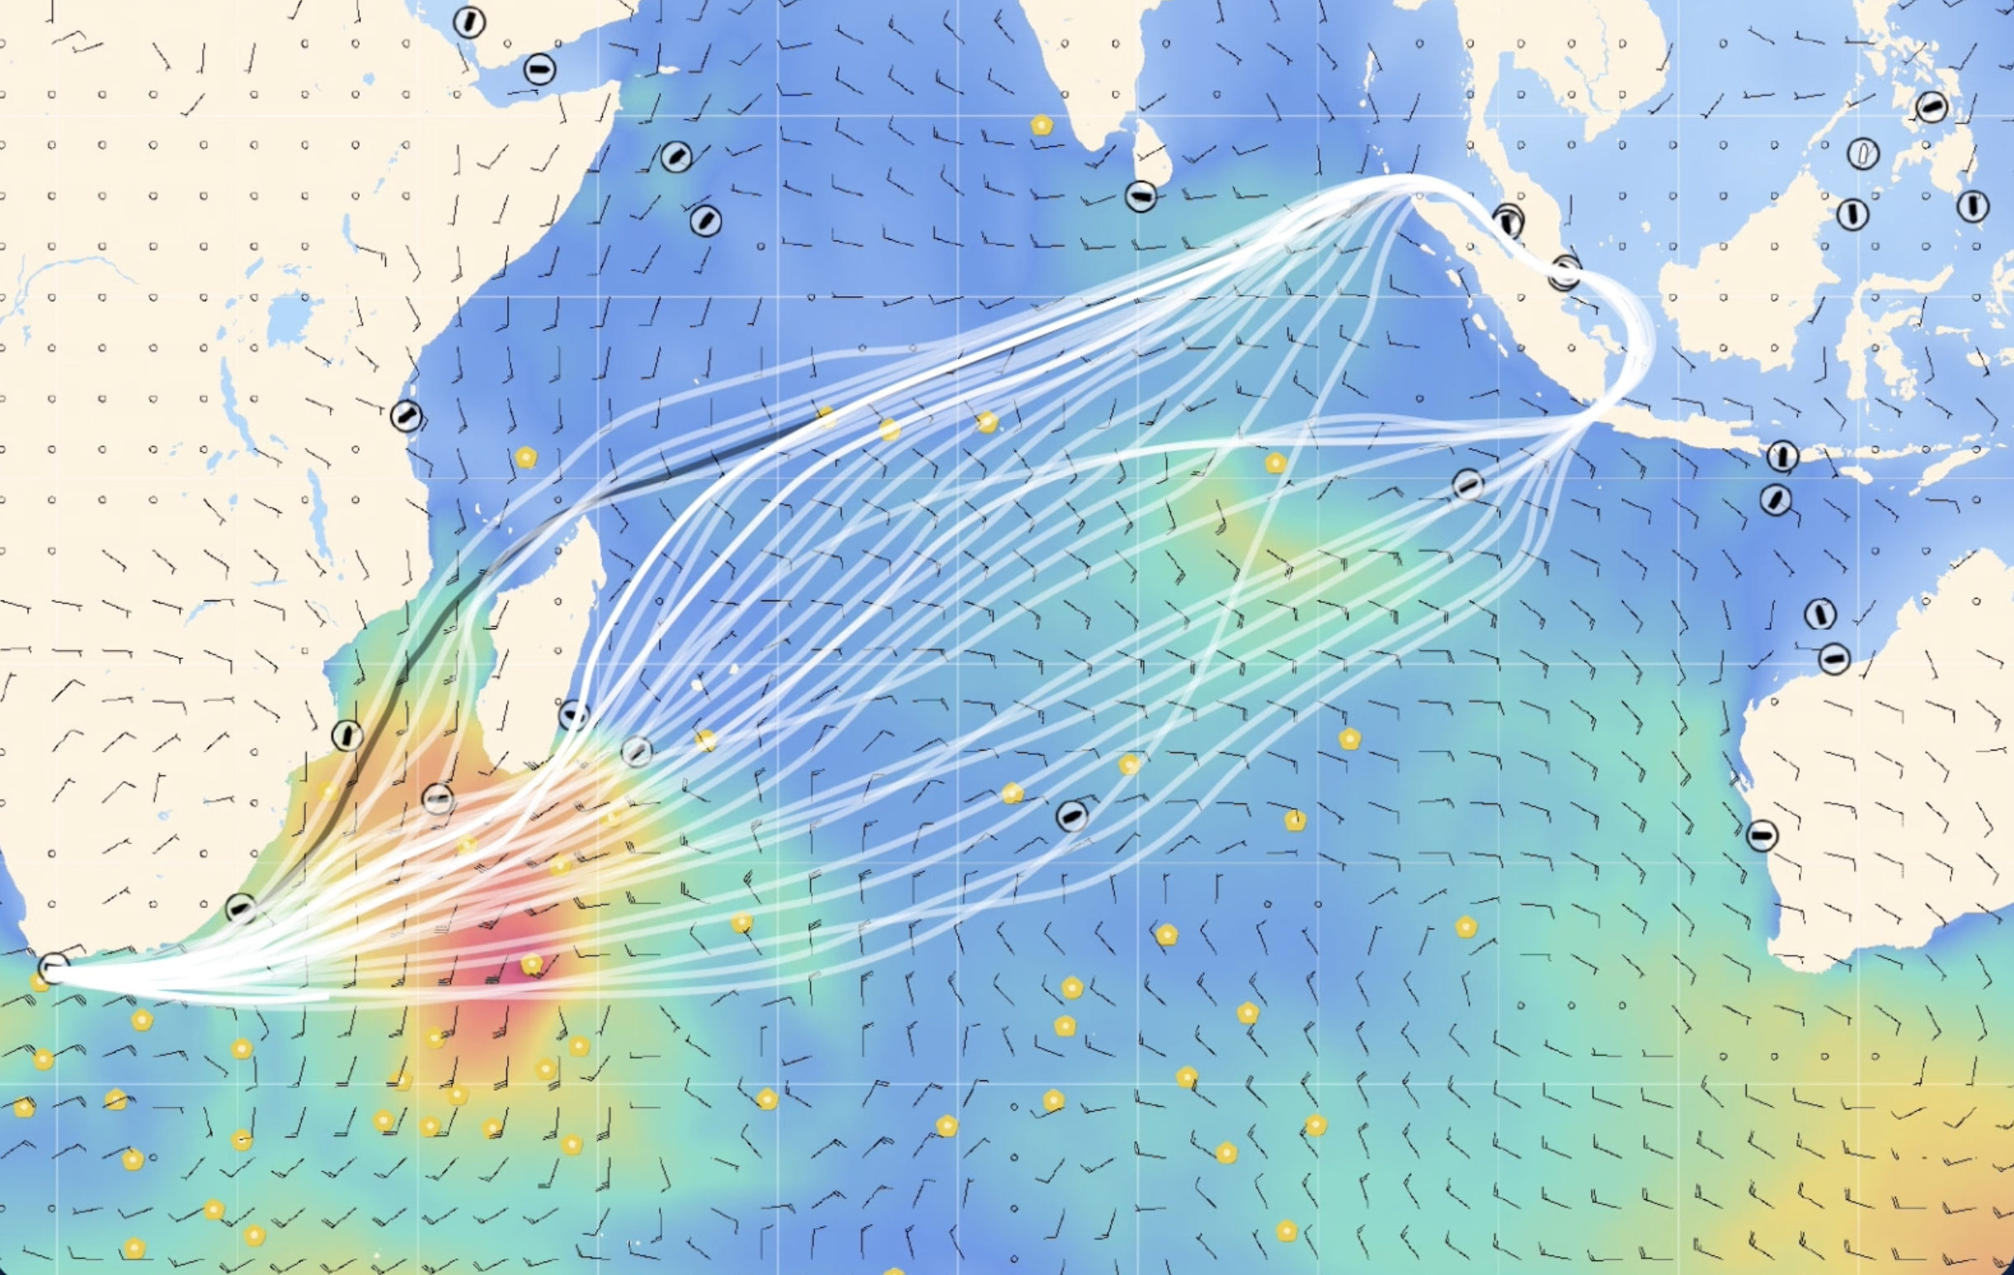
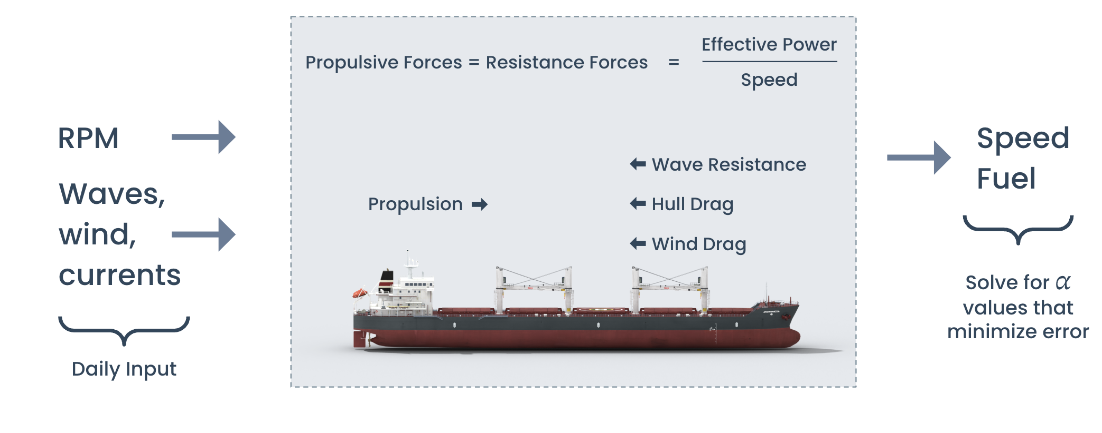

Data scientist & software engineer more recently
Sofar Ocean
Optimal path planning software for commercial cargo ships
Data-driven naval engineering
Embedded signal processing algorithms for wave measurement buoys

Slide 6
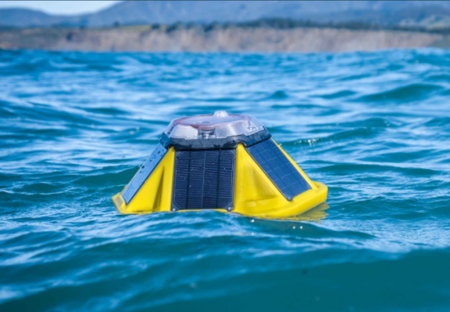
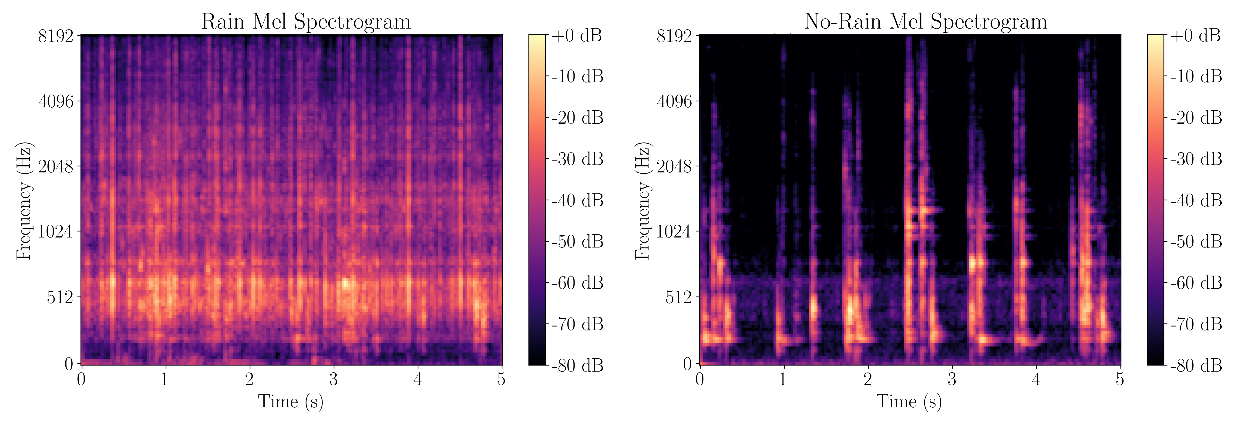
At Seattle U
Continued collaborations with Sofar
e.g., inferring ocean rainfall from microphone audio using ML
Navy-funded research on ocean-atmospheric heat transfer
Applications for weather & climate forecasting
Warmer over here
Colder over here

Slide 7
About You?

Slide 8
This Class: Probability and Statistics for Sciences and Engineering
Probability: Theory that helps us determine how likely it is that something happens
Statistics: Methods for collecting, analyzing, interpreting, and presenting data, often with the goal of making an inference about the subject of the data
Sciences and Engineering: Useful stuff

Slide 9

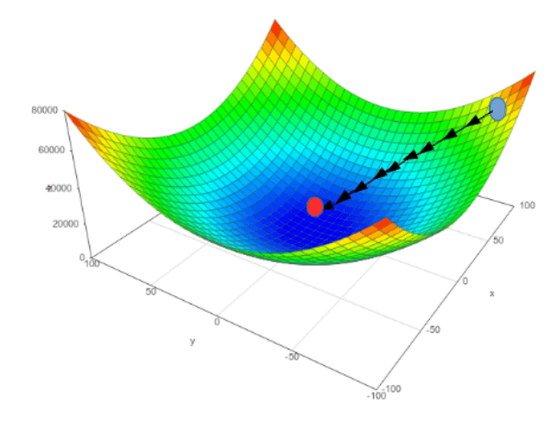
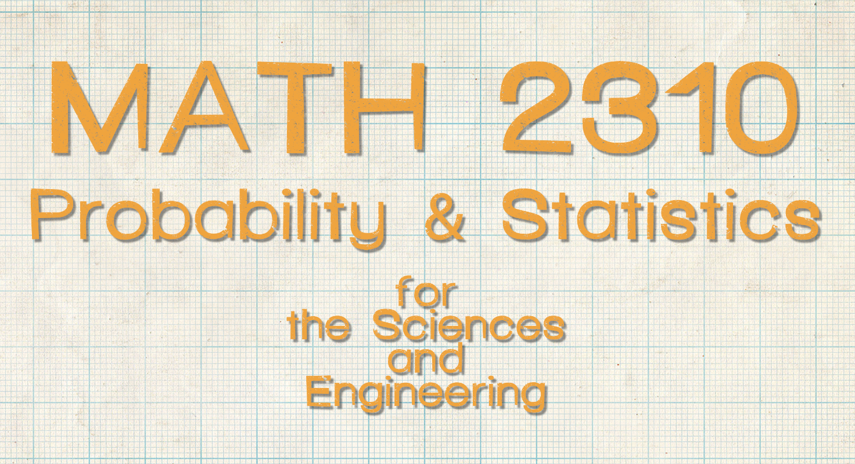
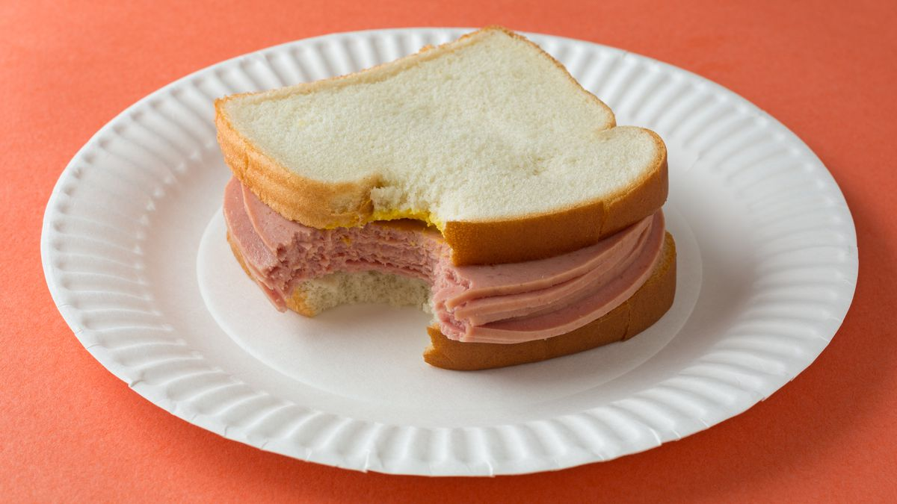
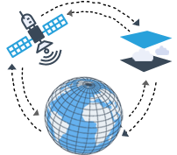

Useful application #1: Machine Learning
Three Pillars of ML
Probability & Statistics (Problem Formulation)
Optimization
(Solution Methods)
Bologna Sandwiches

Slide 10

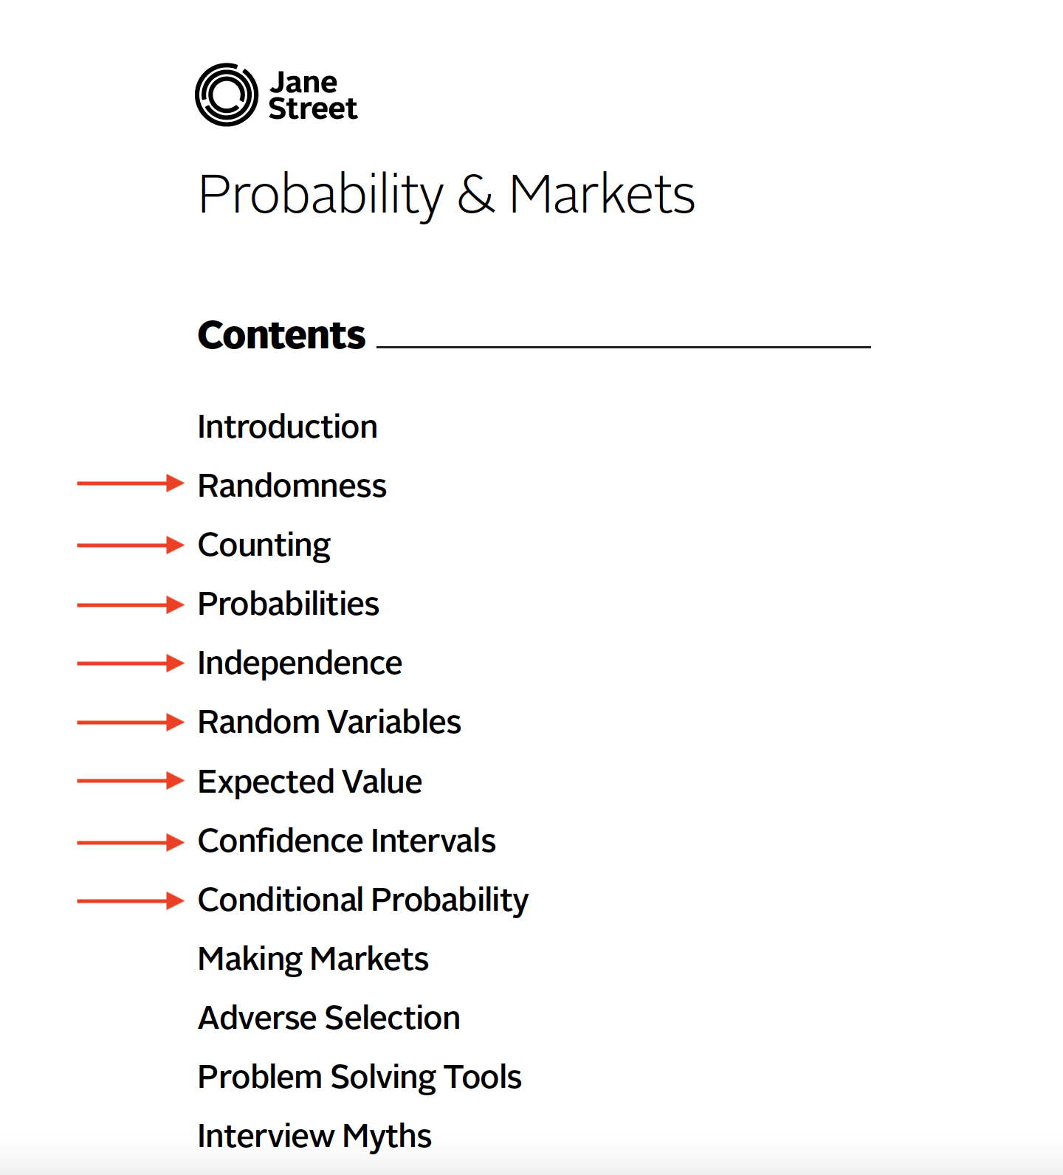
Useful application #2: Finance
Jane Street interview

Slide 11

Useful application #3: Software Engineering
Stop your API from falling over
Autoscaling
Rate limiting
Caching
Requires statistics about usage and probabilistic performance targets, e.g., you want 99% of response times < 100 ms

Slide 12
Syllabus
It's on Canvas

